Slide 1
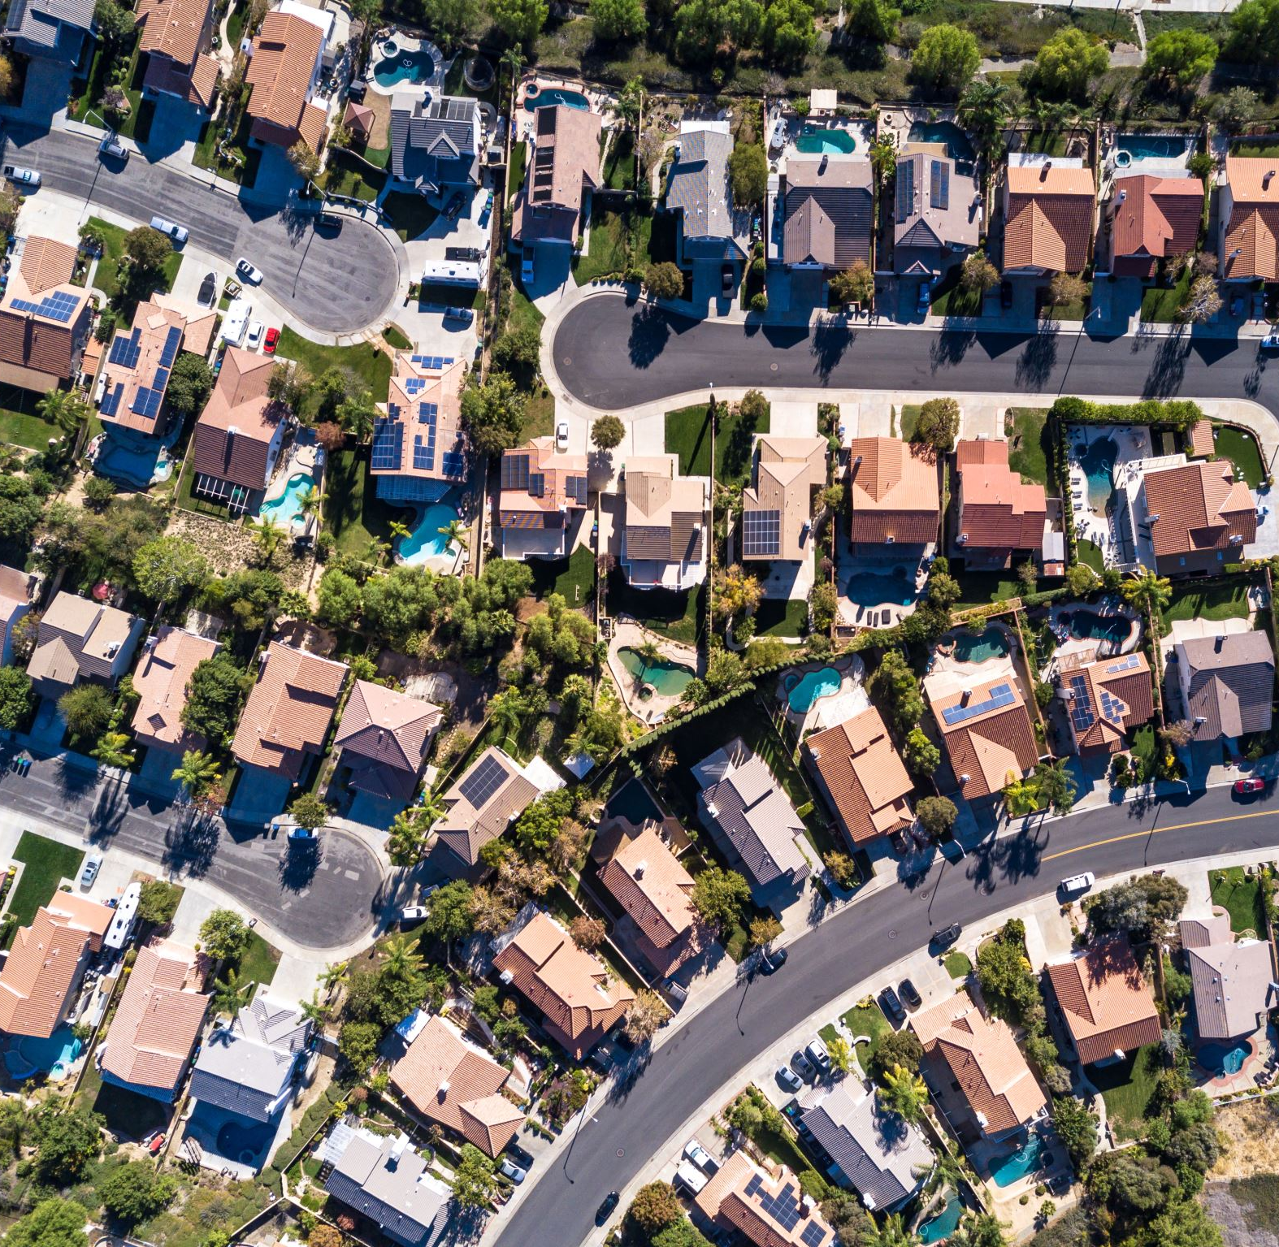

Analysis of San Francisco Housing Market
Methods and tools to act against displacement and gentrification
Pietro Bogani, Tomaso Castellani, Sara Tonazzi
8 CFU 8 CFU 5 CFU

Slide 2
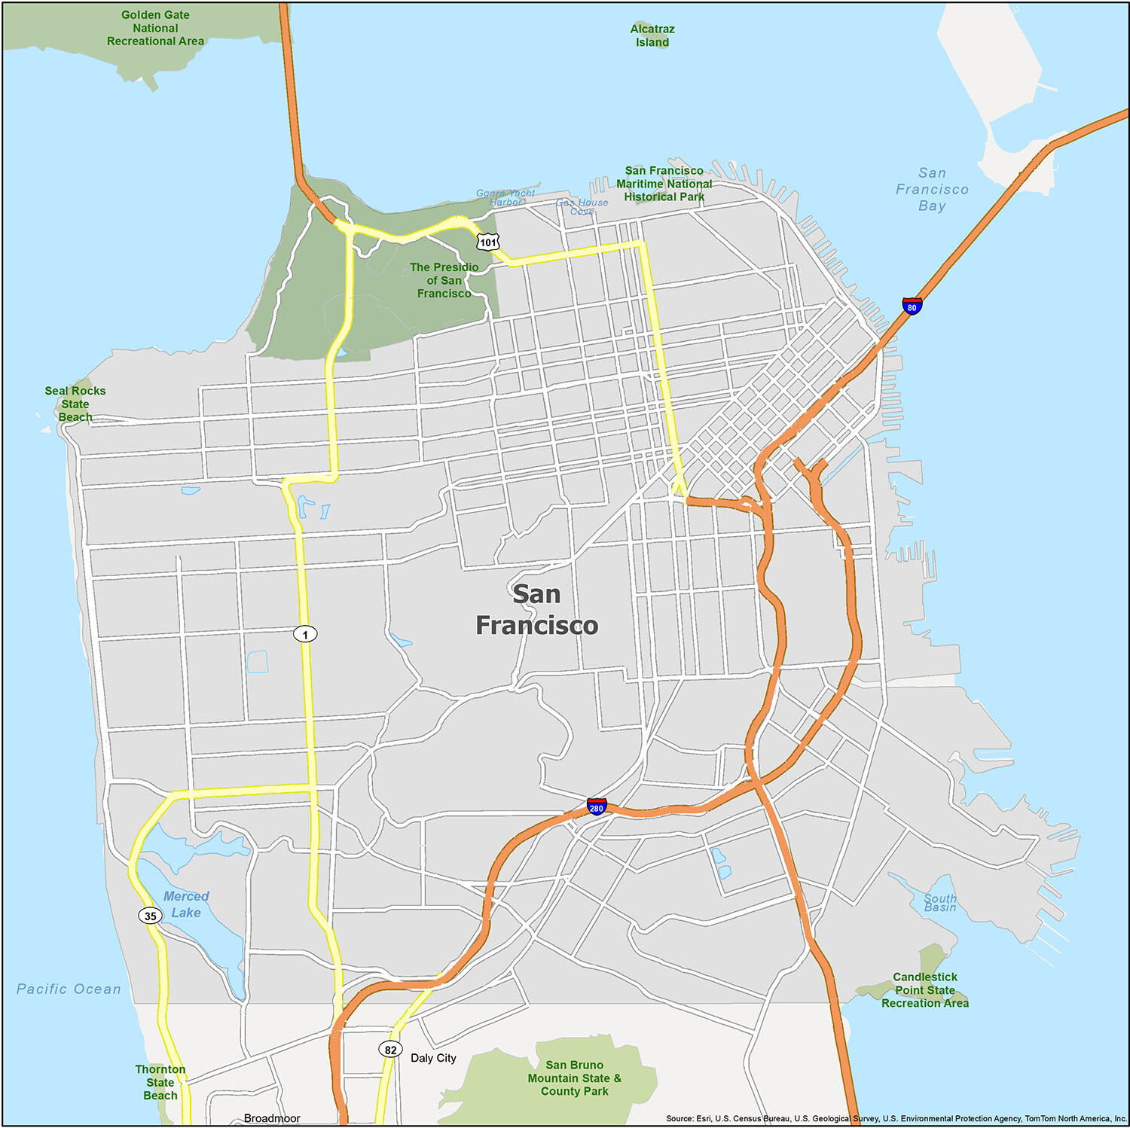
The problem
Gentrification and displacement
The process whereby the character of an urban area is changed by wealthier people moving in, displacing current inhabitants in the process.
Gentrification in San Francisco has increased significantly since the 1990s, driven by a strong demand for tech workers from local startups and Silicon Valley companies.
This process affected negatively the social demographic structure of the city, as San Francisco was becoming the most expensive city in the US.

Slide 3
Goals
Use statistical methods and develop models to understand how the SF housing market has changed in the last 15 years and which factors drived these changes.
Provide to the local government tools to tackle the problem of gentrification and displacement
Further validate previous papers on the topic

Slide 4
Dataset

Slide 5
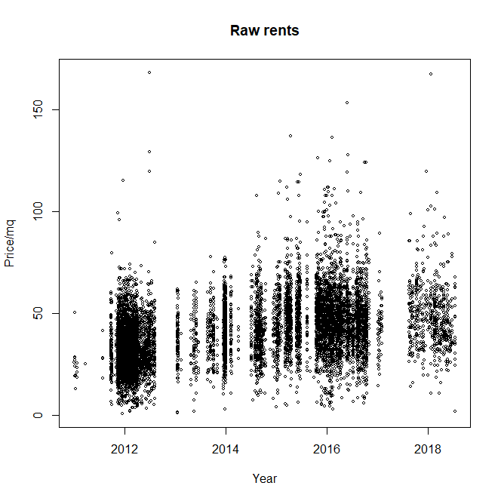

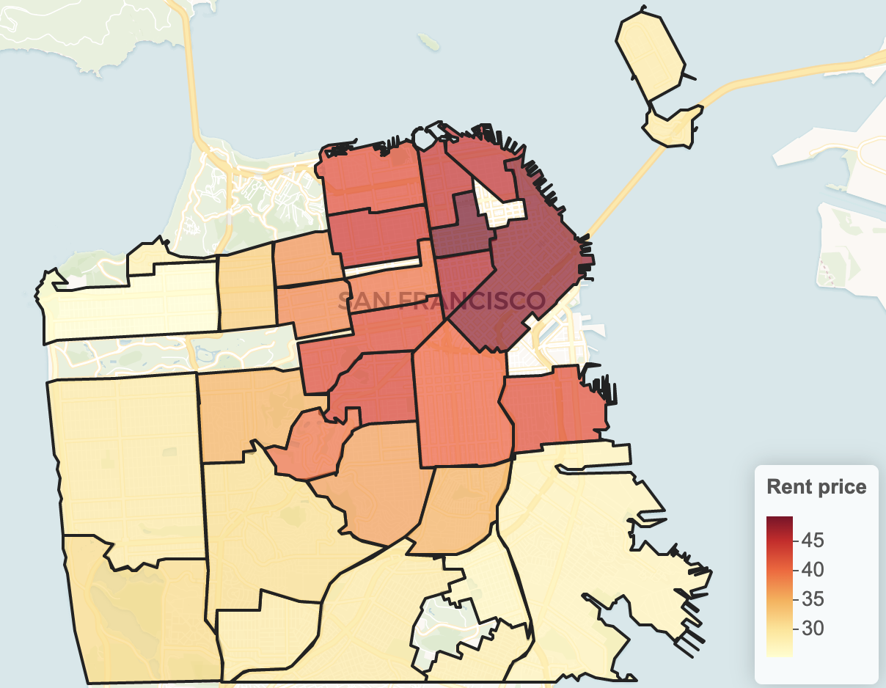
Datasets
Rent
Source: Craiglist.com
Main information:
Neighborhood
Price/mq
Date of the advertisement

Slide 6
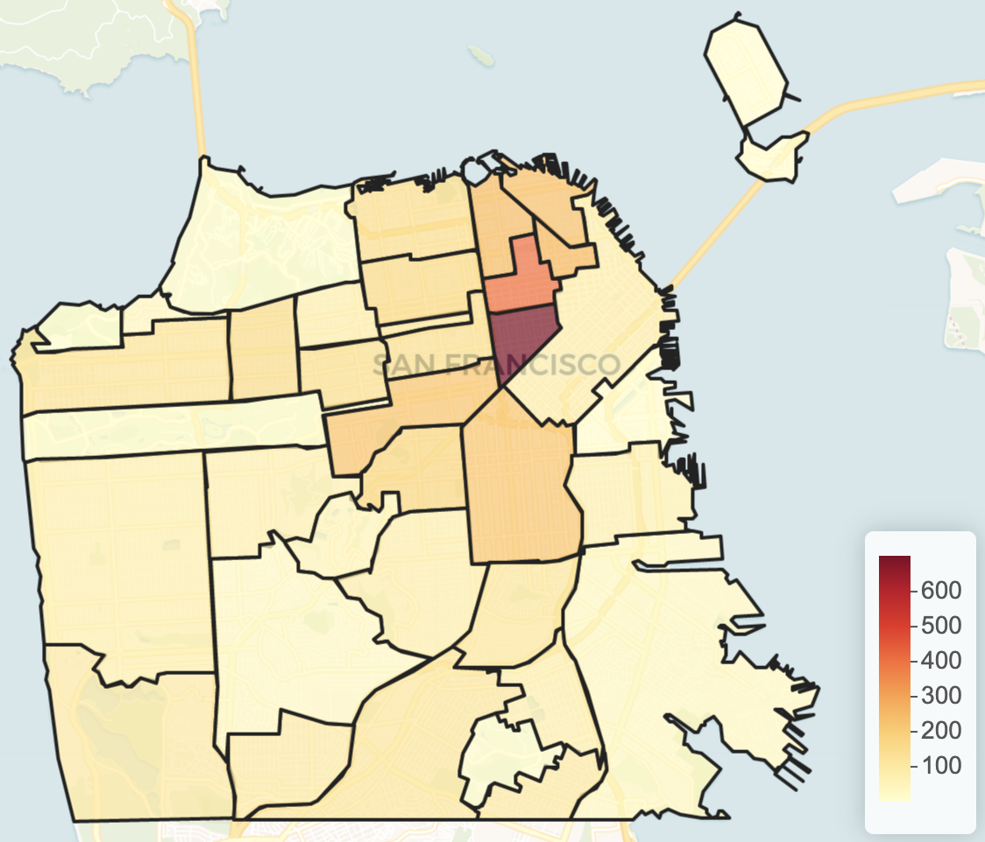

Datasets
Evictions
Source: SF government (datasf.org)
Main information:
Neighborhood
Date

Slide 7
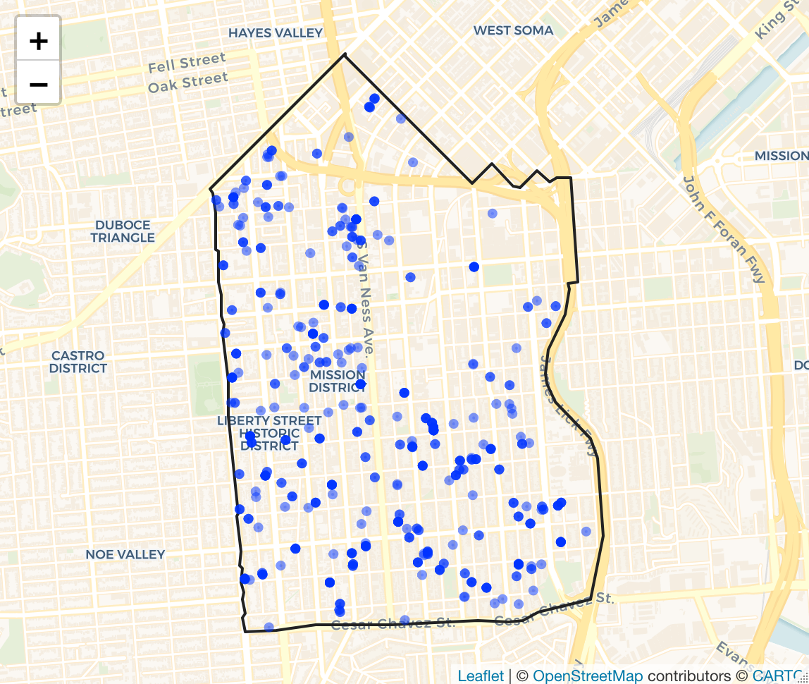

Datasets
Source: SF government (datasf.org)
Main information:
Address (geocoded to coordinates)
Date of permit emission
Existing and proposed number of housing units
Constructions

Slide 8
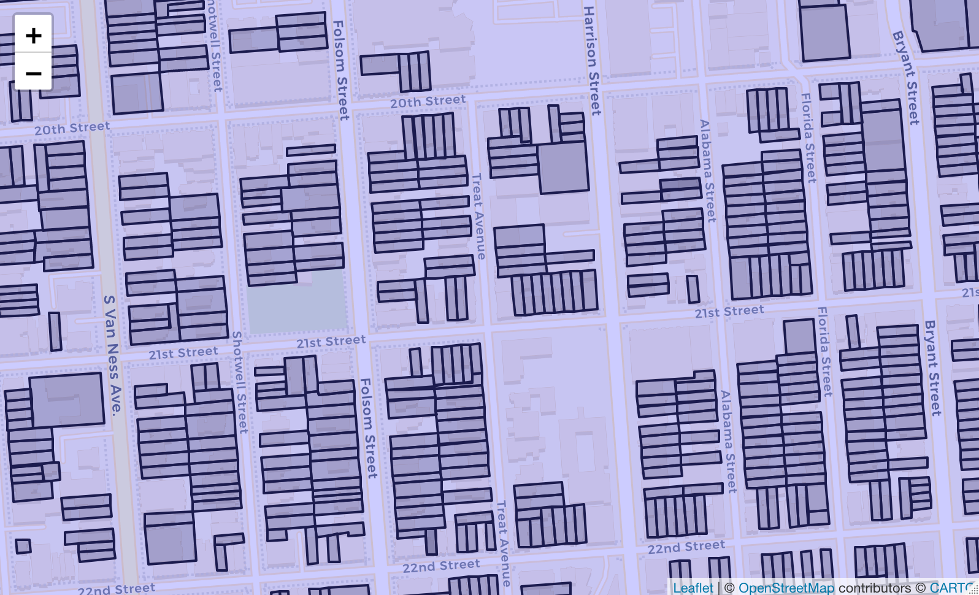

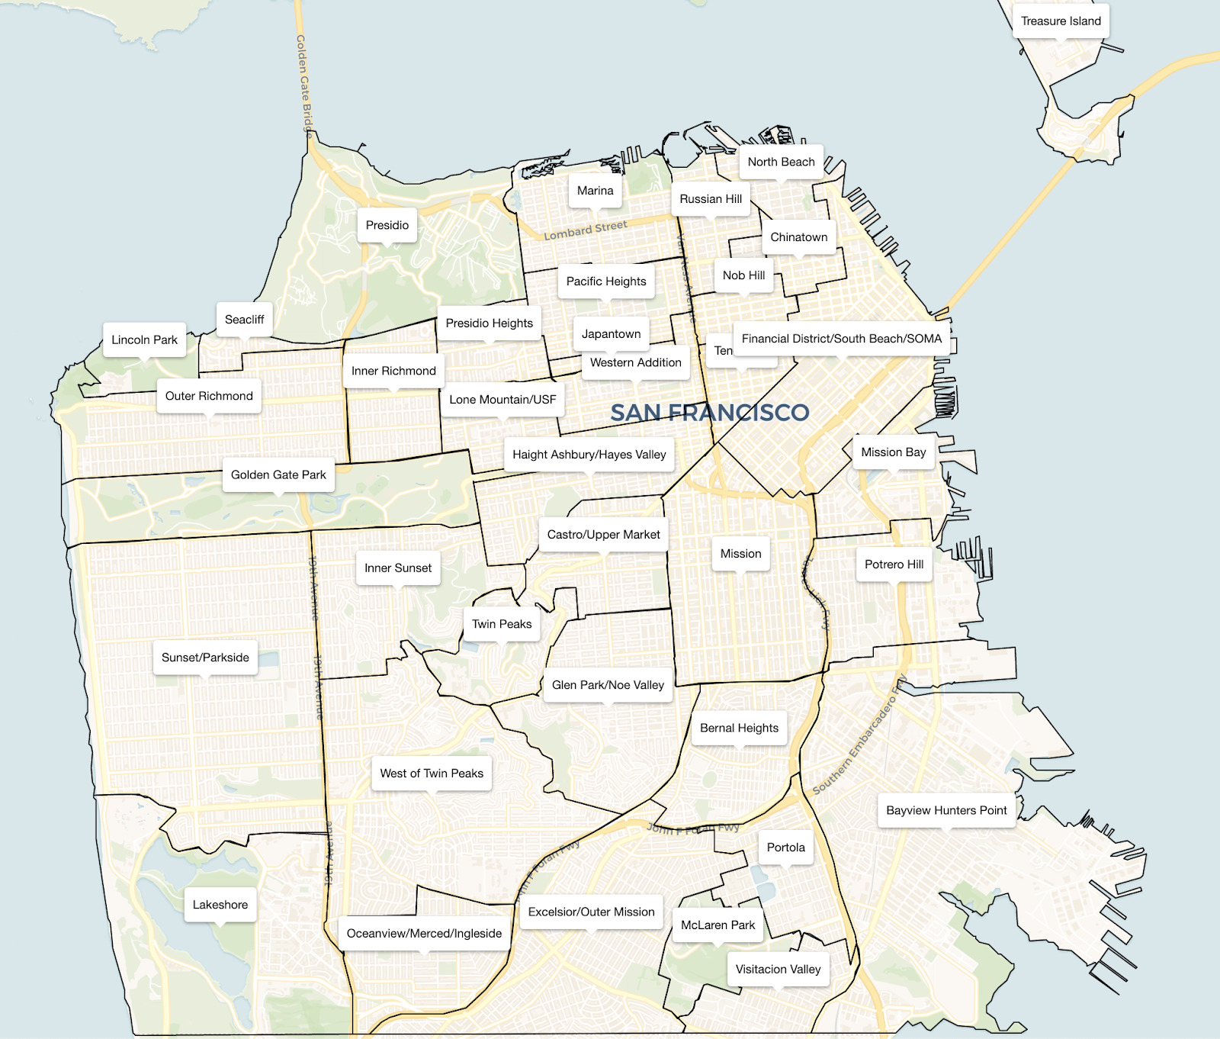
Datasets
Source: SF government (datasf.org)
Main information:
Latitude and longitude of the vertices of the parcel/neighborhood
Number of house units for each parcel
Parcels
&
Neighborhoods

Slide 9
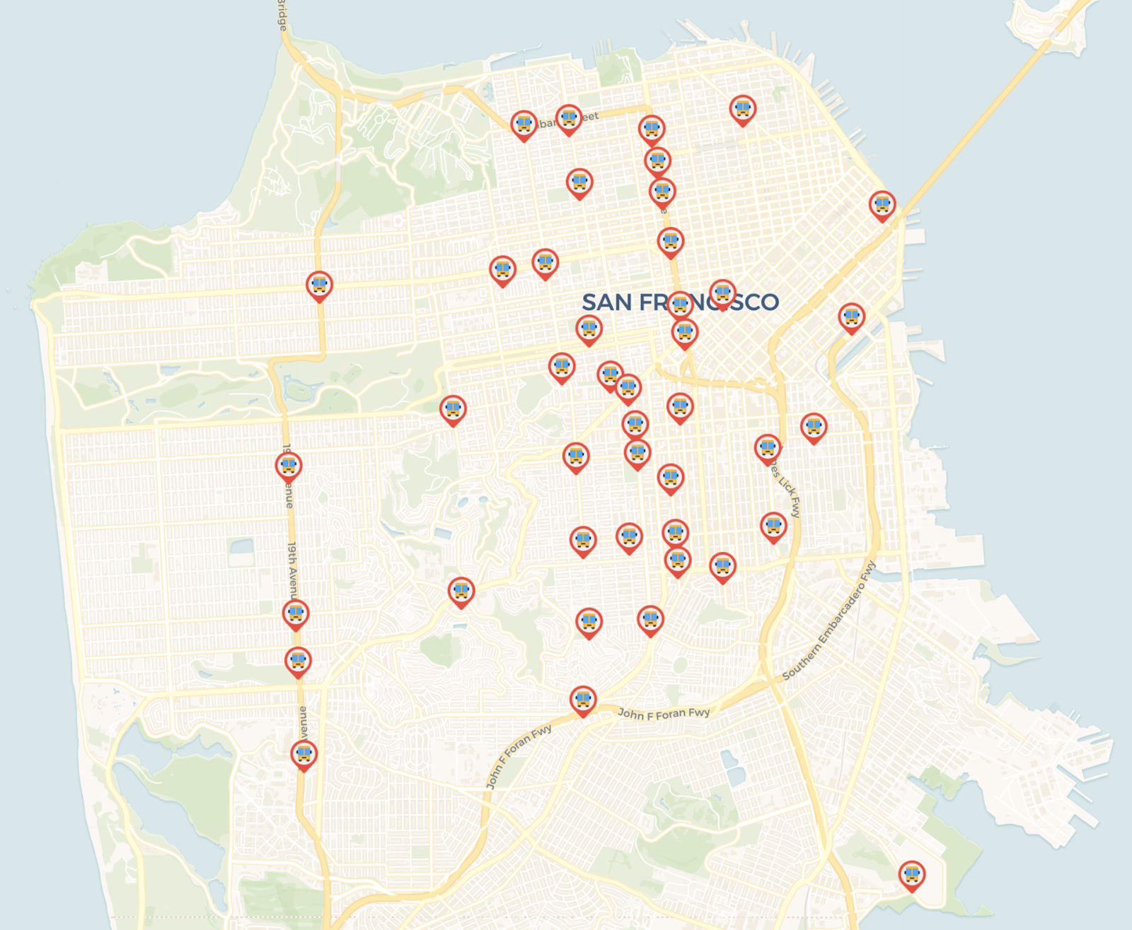

Datasets
Google Bus Stops
Source: Stamen Design
Main information:
Latitude and longitude of the estimated bus stop

Slide 10
Trends analysis

Slide 11
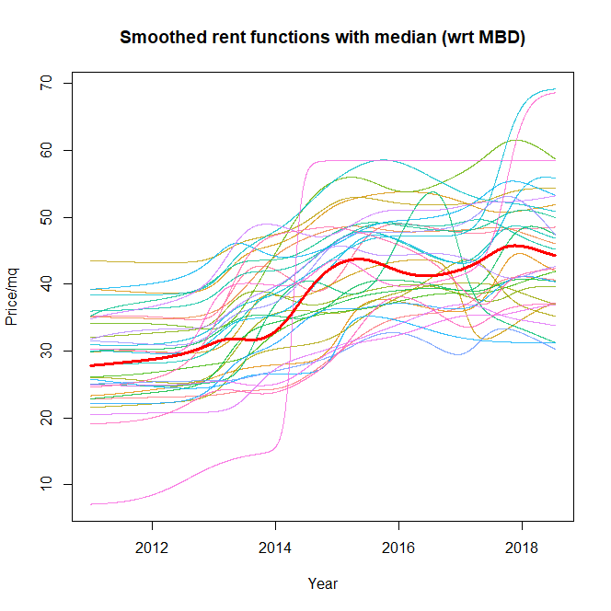
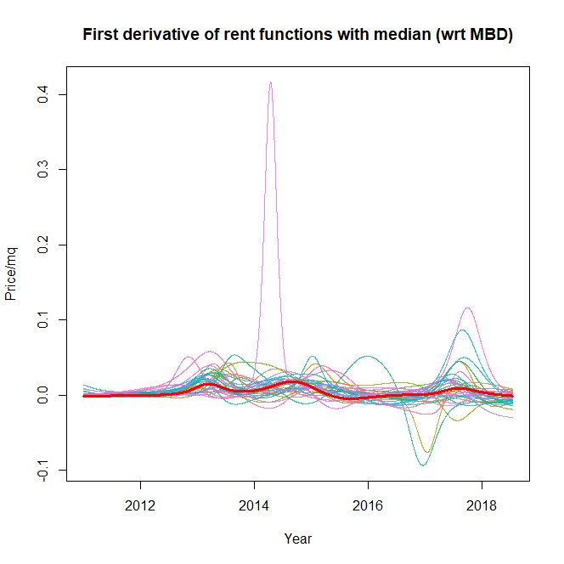
Rent
functions

Slide 12
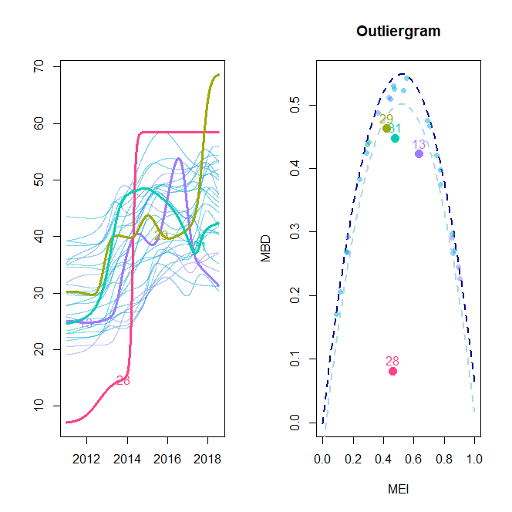
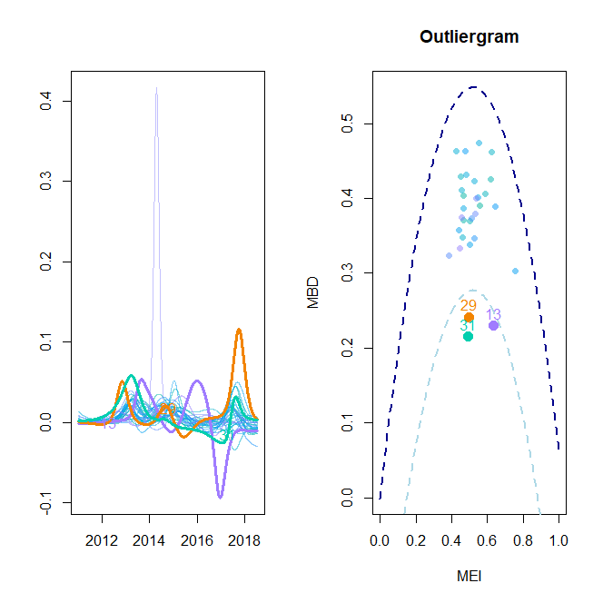
Outlier detection
Shape outliers
We remove only Tresure Island (28), an artificial island scarcely inhabited

Slide 13
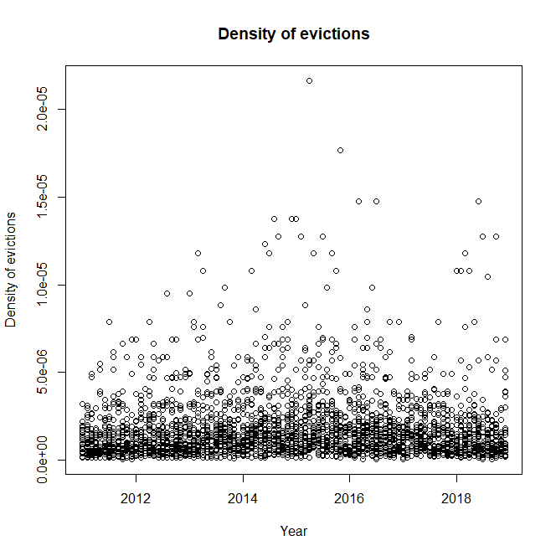
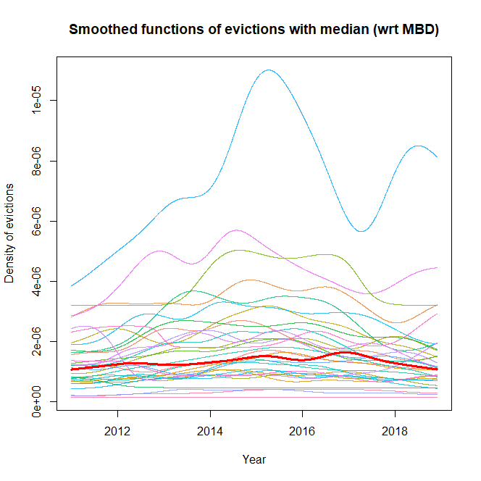
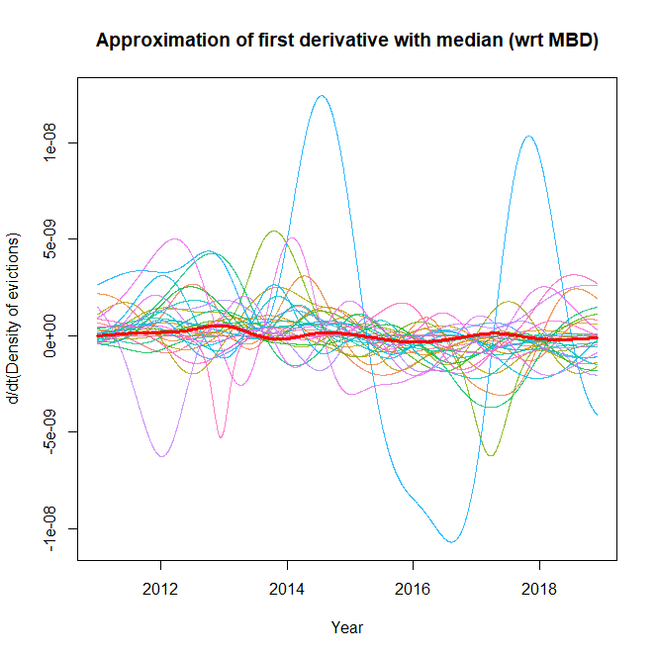
Eviction
density functions

Slide 14
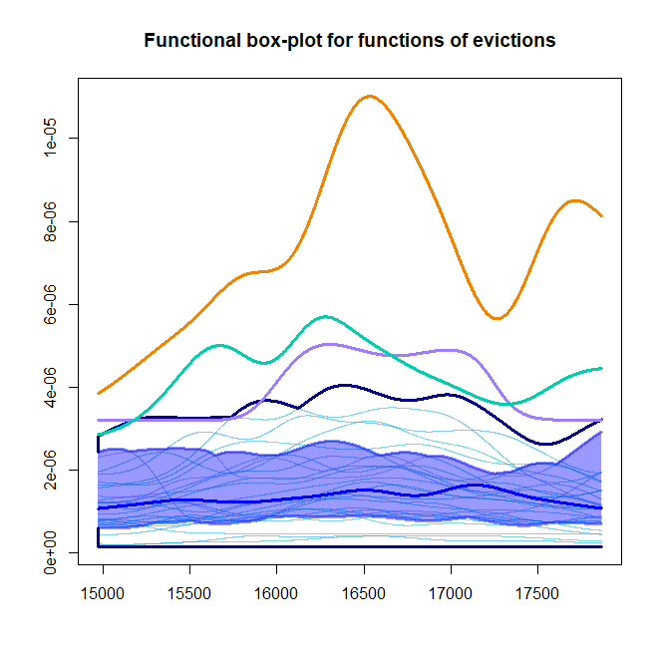
Outlier
detection
Magnitude outliers
Japantown, Tenderloin and Nob Hill

Slide 15
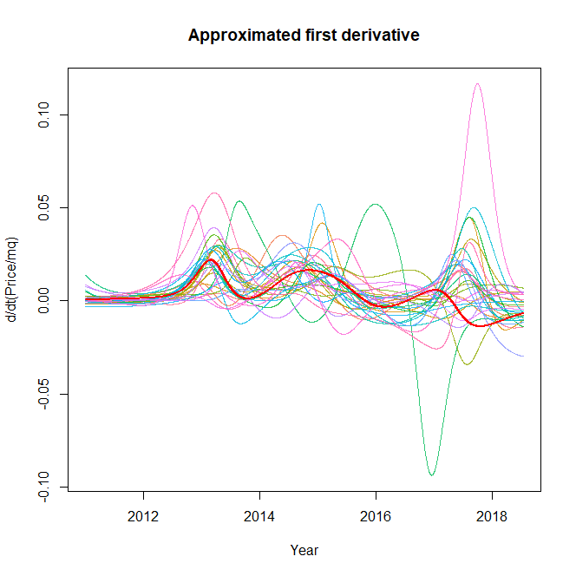
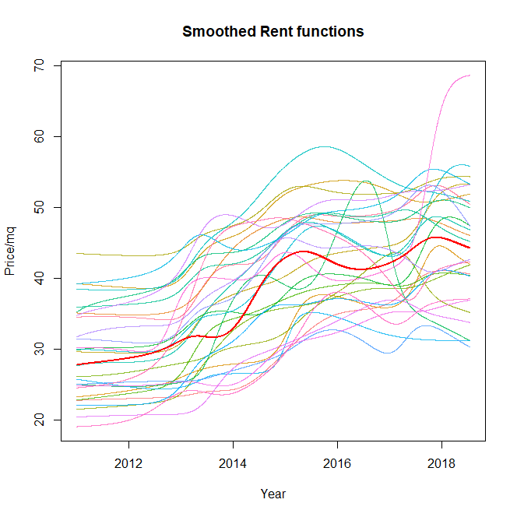
Rent functions
Eviction density functions

Slide 16
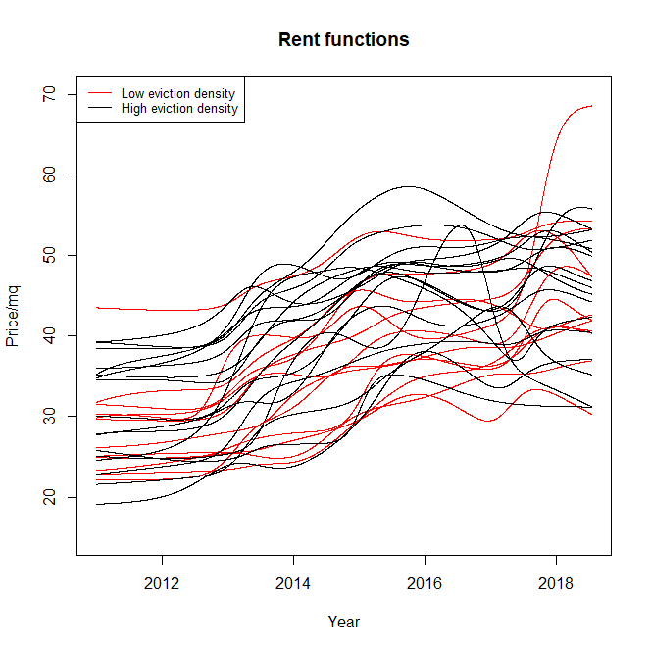
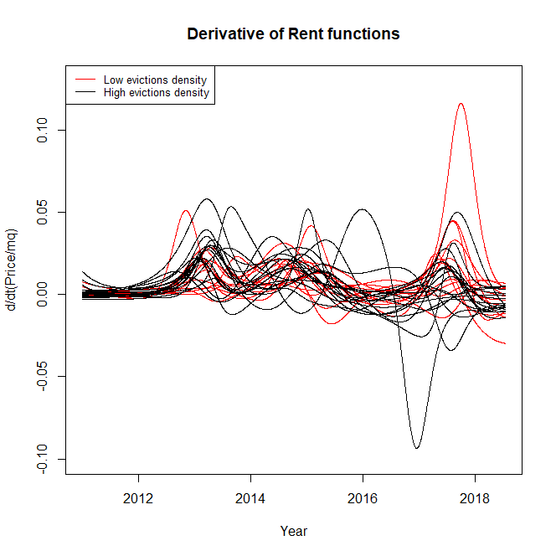
Tests on
rent functions
based on evictions
P-value: 0.378
P-value: 0.748
There is not significant difference

Slide 17
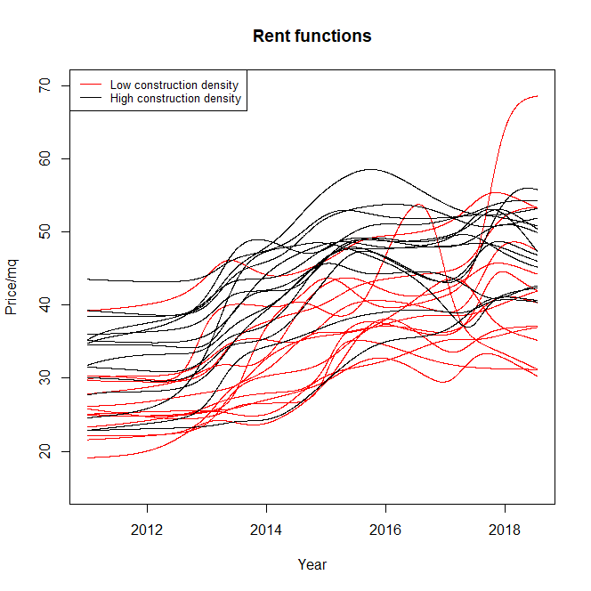
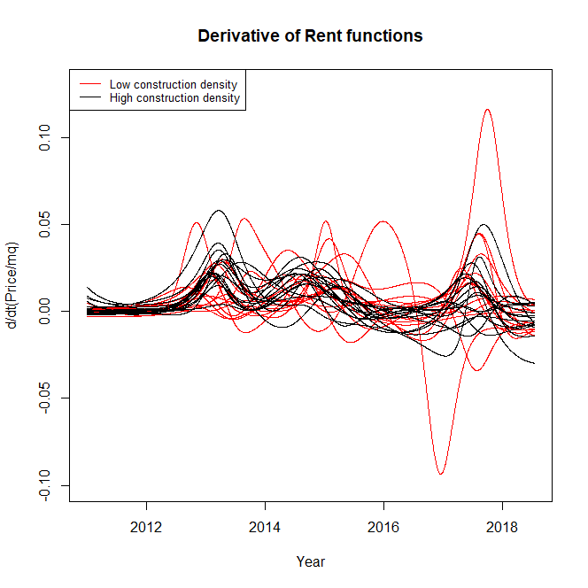
Tests on
rent functions
based on
constructions
P-value: 0.031
P-value: 0.561
There is difference for the rent functions but not in their derivatives

Slide 18
Constructions effect on evictions

Slide 19
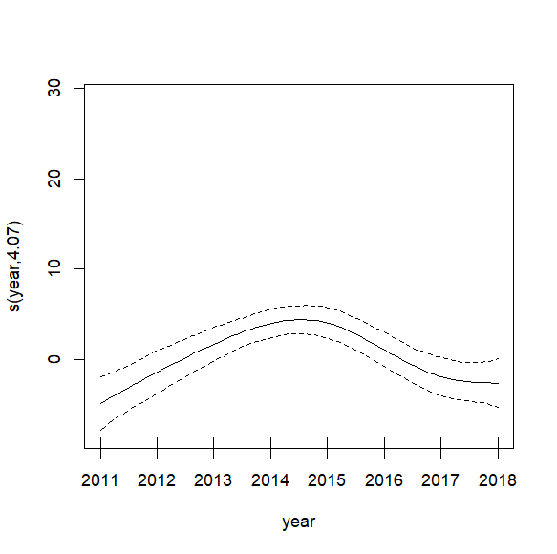
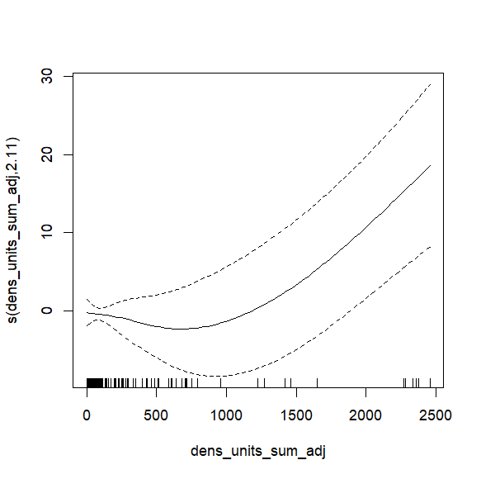
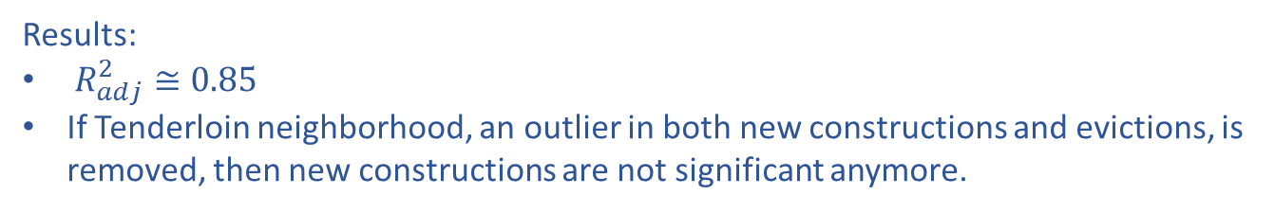
Neighborhood
granularity
$${eviction}_{nhood,year} = β_{0}+β_{nhood}+f_{1}\left(year\right)+f_{2}\left(density of new construction in nhood\right)$$
Results:
$R_{adj}^{2}≅0.85$
If Tenderloin neighborhood, an outlier in both new constructions and evictions, is removed, then new constructions are not significant anymore.

Slide 20
Constructions effect on rents

Slide 21
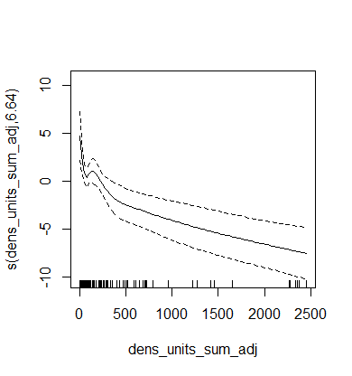
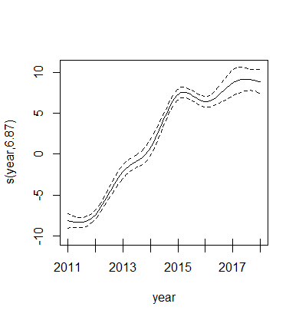

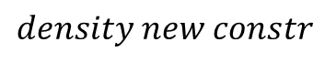



Neighborhood
granularity
$${rent price}_{nhood,time} = β_{0}+β_{nhood}+f_{1}\left(year\right)+f_{2}\left(density of new construction in nhood\right)$$
Results:
$R_{adj}^{2}≅0.37$
All predictors are significant
$$f_{2}\left(density new constr\right)$$
$$f_{1}\left(year\right)$$
$$density new constr$$
$$year$$

Slide 22

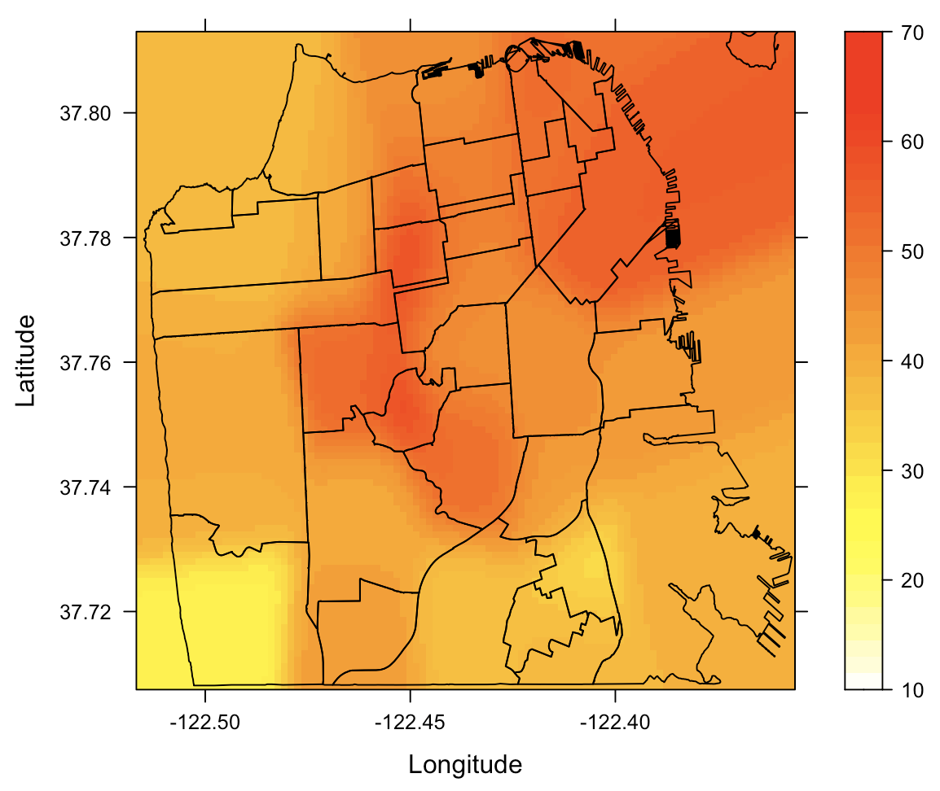

Gaussian Kernel
Smoothing
2D
Average price
in each neighborhood
Gaussian Kernel Regression
Advertisements
Improvement
Consider the small fraction of rents with coordinates as standalone observations and not as part of the neighborhood mean, adding proper weights

Slide 23
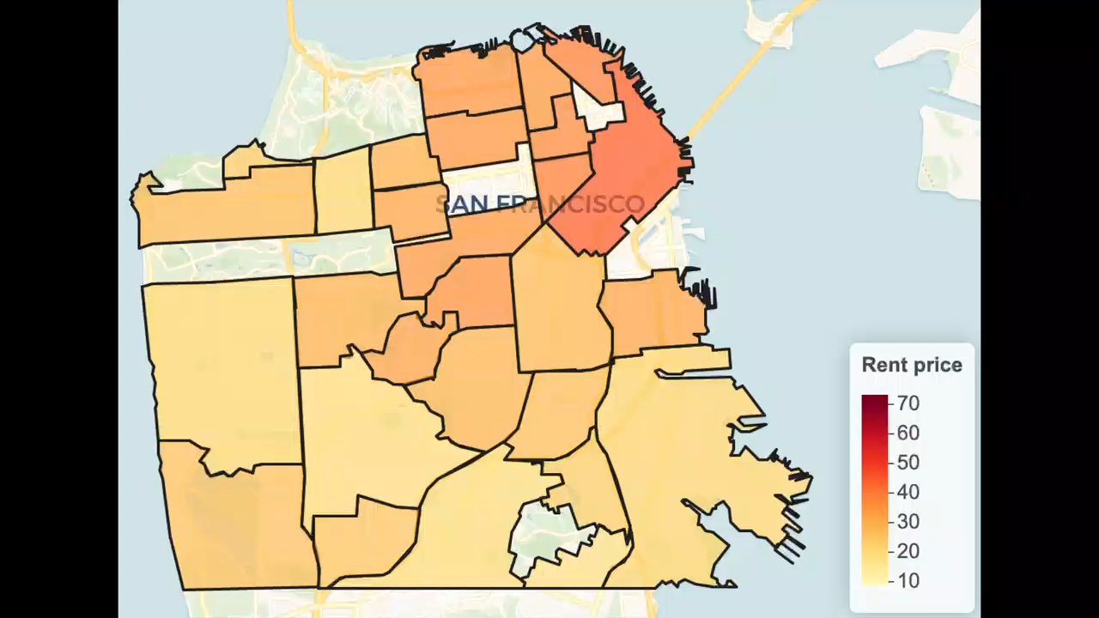
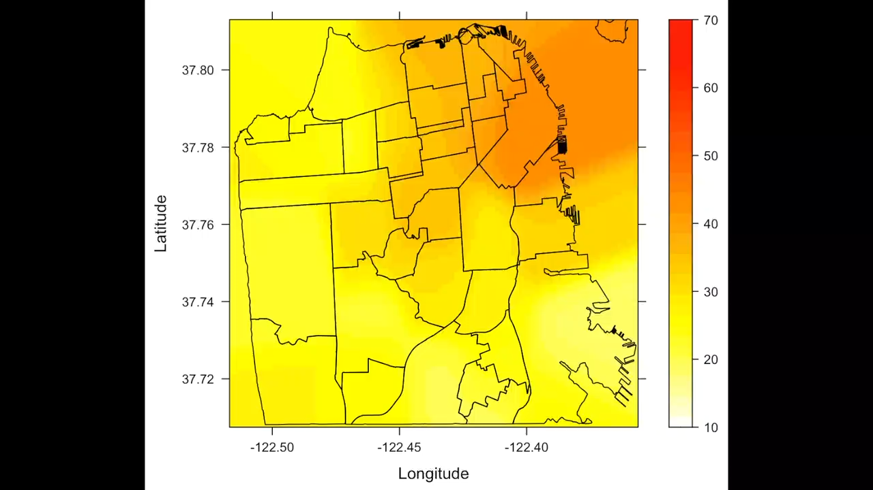
Gaussian Kernel
Smoothing
2D

Slide 24
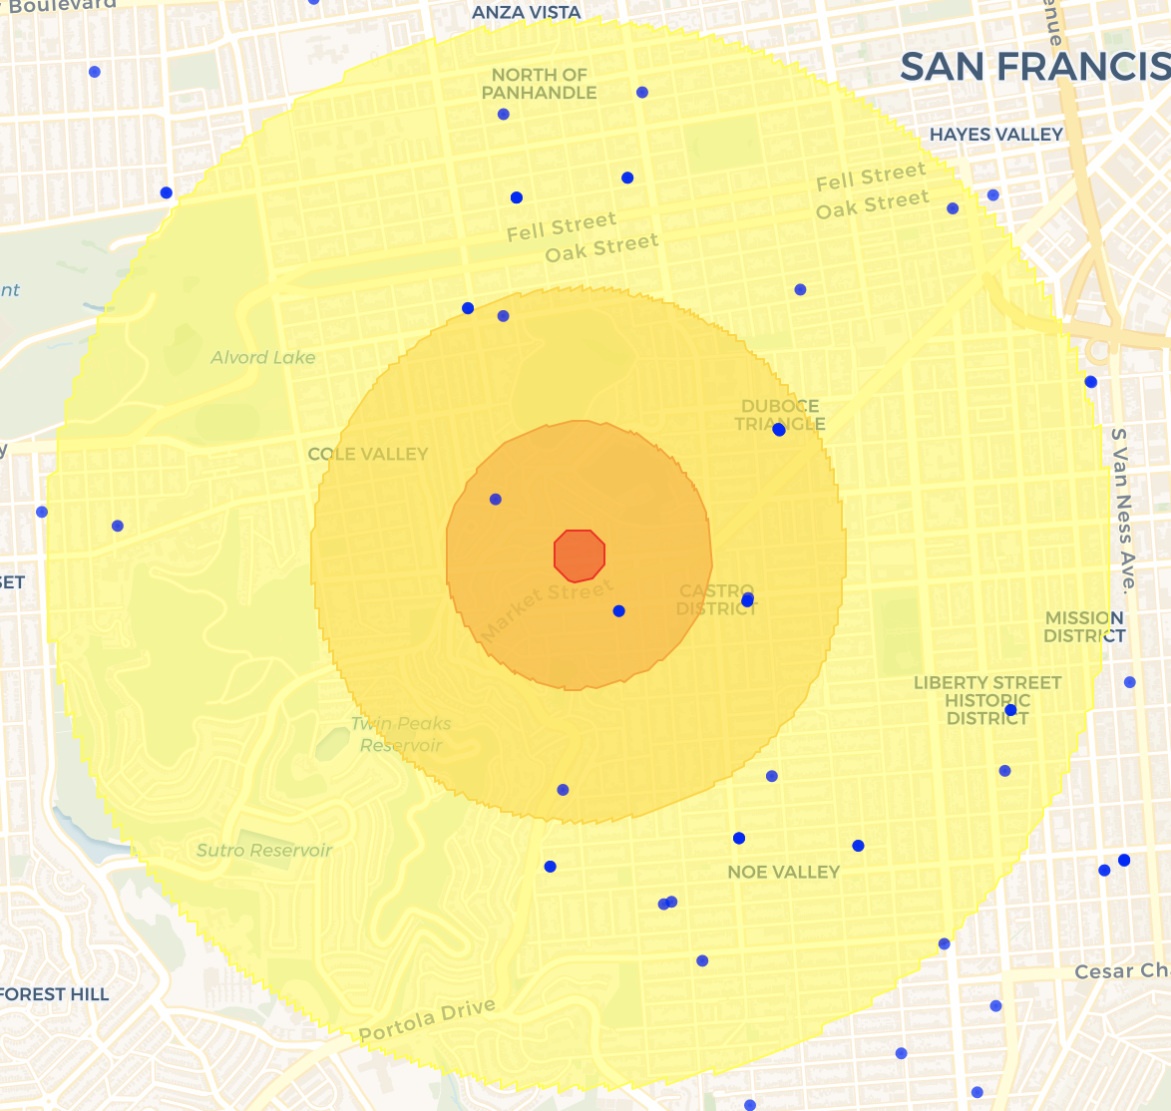
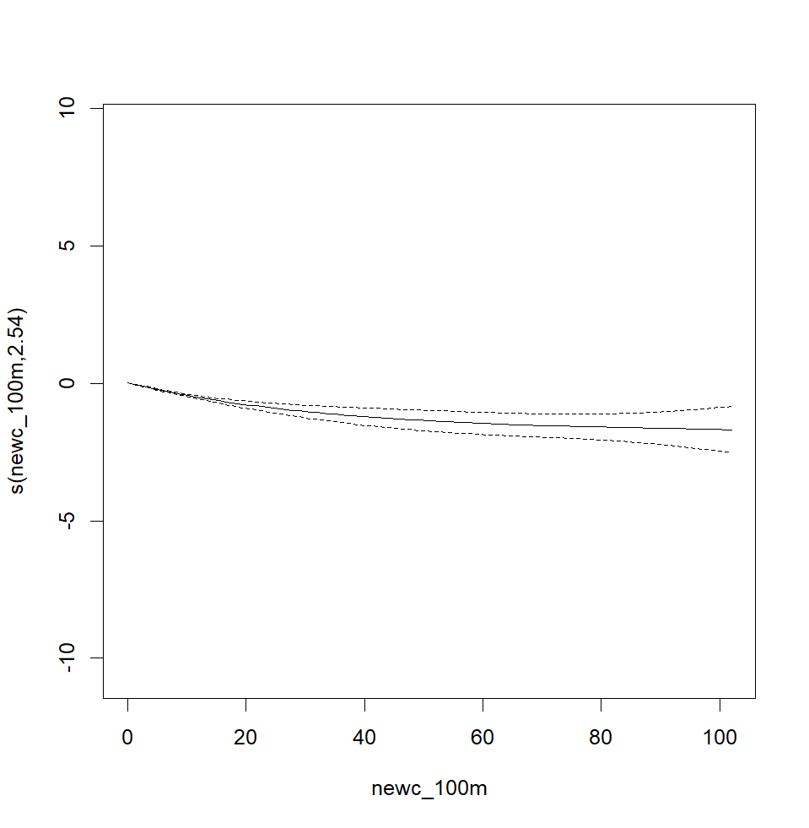
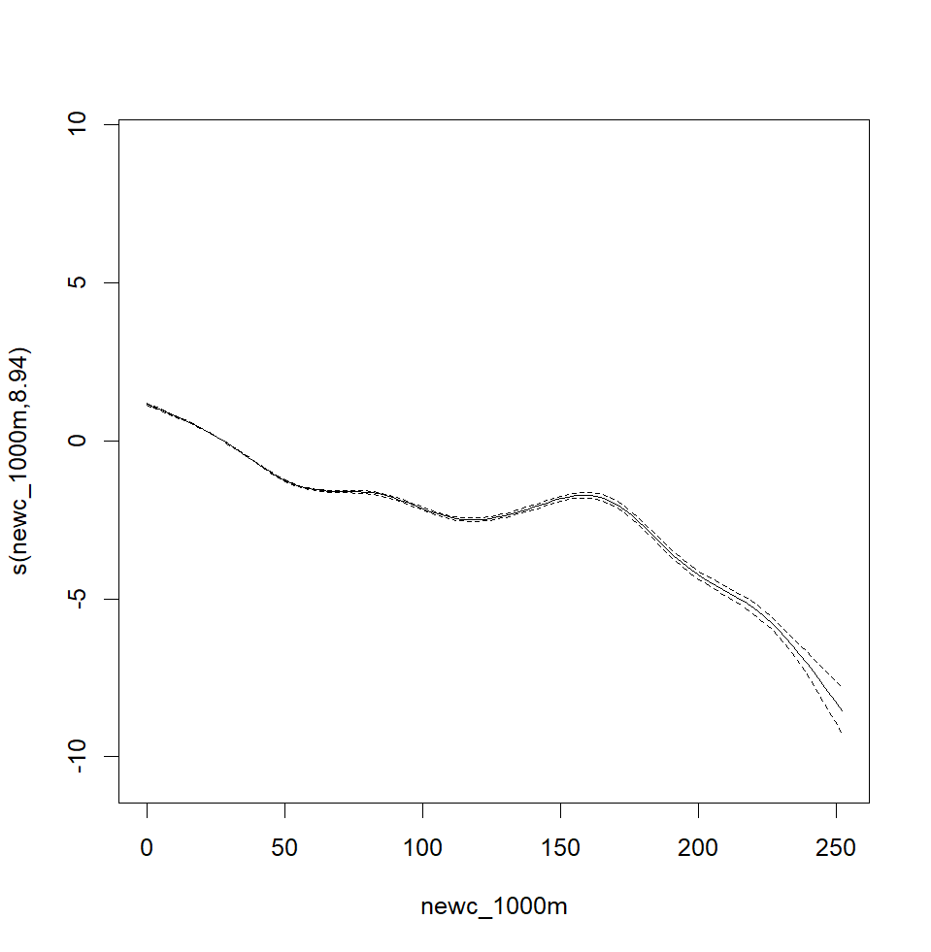
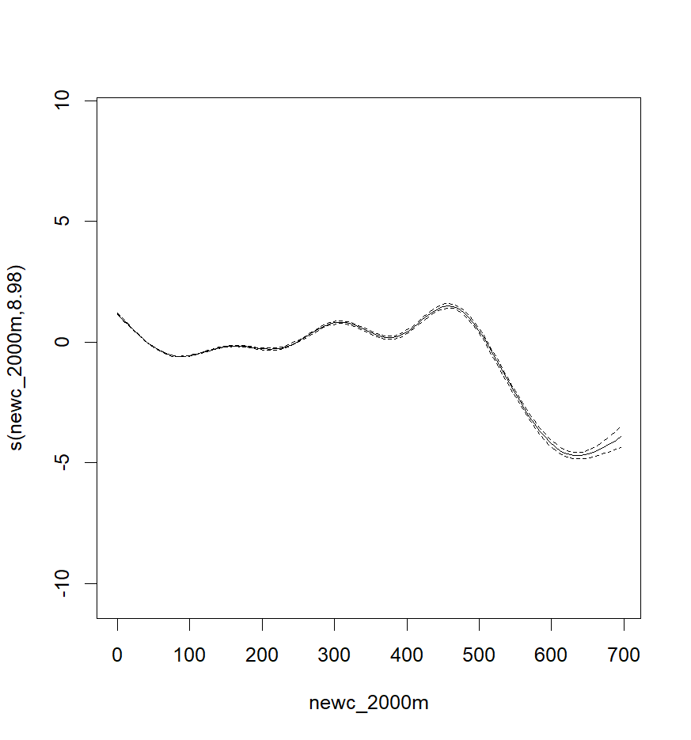



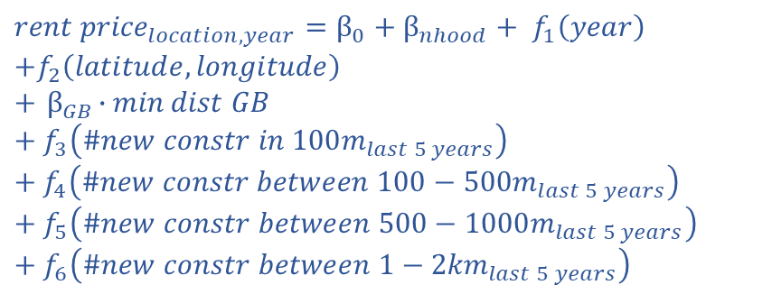


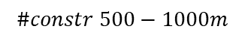
Parcels
granularity
$${rent price}_{location,year}=β_{0}+β_{nhood}+ f_{1}\left(year\right)$$
$$+f_{2}\left(latitude,longitude\right)$$
$$+{ β}_{GB}∙\min{dist GB}$$
$$+ f_{3}\left({\#new constr in 100m}_{last 5 years}\right)+f_{4}\left({\#new constr between 100−500m}_{last 5 years}\right)+f_{5}\left({\#new constr between 500−1000m}_{last 5 years}\right)+f_{6}\left({\#new constr between 1−2km}_{last 5 years}\right)$$
Results: $R_{adj}^{2}≅0.85,\text{all} \text{predictors} \text{are} \text{significant},β_{GB}=−0.74$
$$f_{5}\left(\#constr 500−1000m\right)$$
$$f_{6}\left(\#constr 1−2km\right)$$
$$f_{3}\left(\#constr 100m\right)$$
$$\#constr 100m$$
$$\#constr 500−1000m$$
$$\#constr 1−2km$$

Slide 25
Conclusions

Slide 26

Conclusions
Rent prices and evictions are not equivalent measures of gentrification.
The impact of new constructions on eviction notices results negligible (at neighborhood level).
New constructions appear affecting the rent prices: building new house units lowers rent prices.
Google bus stops have a negative impact on prices. Landlords could consider applying higher rents, knowing that the houses near a Google bus stop could be attractive for tech workers.
Encouraging the construction of new house units in the city is a good policy for tackling the gentrification and displacement phenomena.

Slide 27
Extra

Slide 28

Improvements
&
Ideas
Obtaining the official data on rent with complete information about the whole market
Obtaining data on evictions with location
Survival models to estimate time-to-displace (data of the recordings of the addressed of some SF citizens. Very sensitive and hard to obtain)
Functional regression model namely considering both the response and the variables as functions of time
Investigate on the effect of different types of constructions (affordable and not affordable)

Slide 29



Gaussian Kernel
Smoothing
2D
Average price
in each neighborhood
Advertisements
(not geolocated)
$w=$ $\#{advertisements}_{nhood}$
Geolocated observations
Gaussian Kernel Regression
Advertisements
(geolocated)
$$w= 1$$

